Slide 1
AES Boot Check

Slide 2
AES Boot Check Memory assignment
0x14000
USER APROM END
User AES KEY
USER APROM
0x4000
AES KEY CHECK
XOM AREA
0x2000
ISP BOOT LOADER
CONFIG BOOT APROM
0x0000

Slide 3
Sample code source path
ISP BOOT LOADER
  \SampleCode\ISP\ISP_UART
User app
  \SampleCode\StdDriver\GPIO_OutputInput
ASE signed Bin file tool
  \nu_com_isp_sboot\out\build\x64-debug

Slide 4
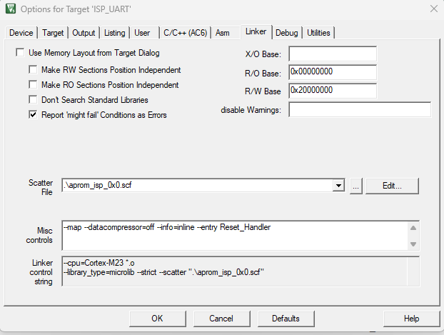
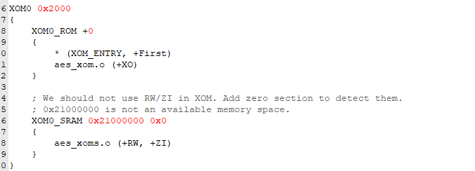
ISP BOOT LOADER
Xom set

Slide 5
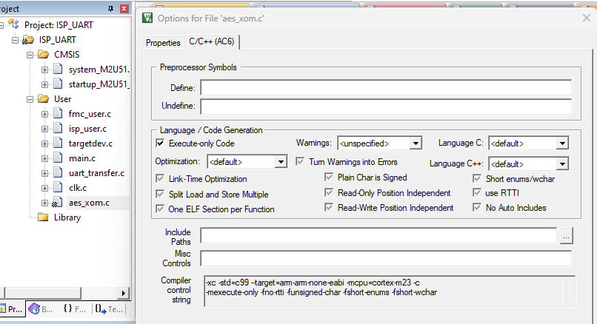
AES_XOM.C file setting

Slide 6
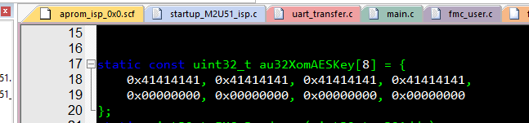
AES KEY in AES_XOM.C

Slide 7
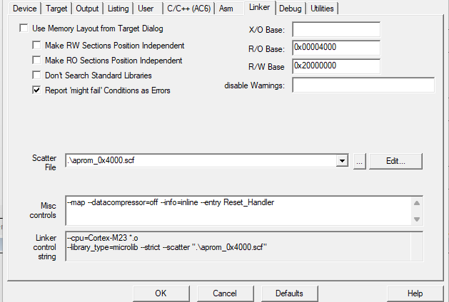
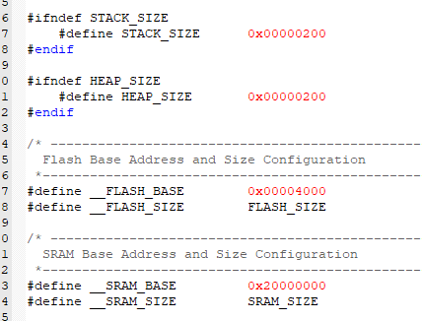
User APROM Project (RO and scf file)

Slide 8
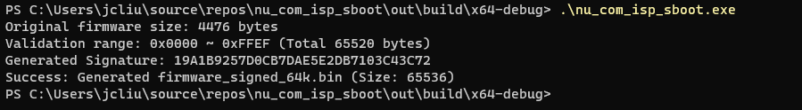
Build User APROM Project and ASE signed key
Build user aprom project will output firmware.bin
  After Build - User command #1: fromelf --bin ".\obj\firmware.axf" --output ".\obj\firmware.bin“
Copy “firmware.bin” to \SampleCode\nu_com_isp_sboot\out\build\x64-debug
Run nu_com_isp_sboot.exe output firmware_signed_64k.bin

Slide 9
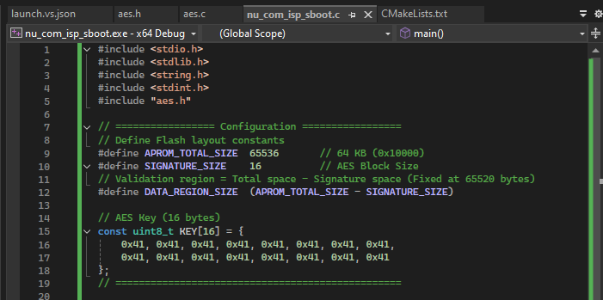
AES key in Nu_com_isp_sboot.c

Slide 10
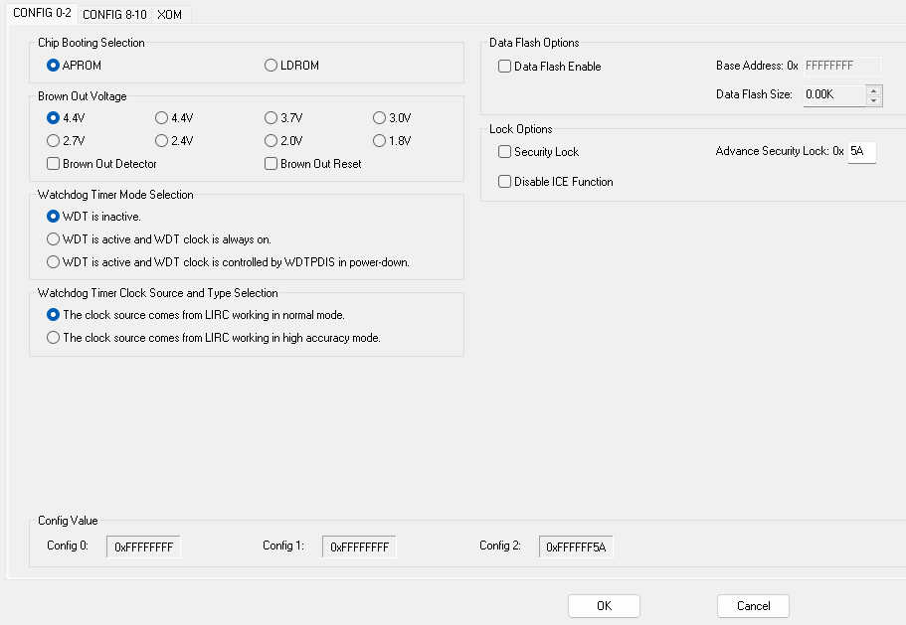
M2U51 config
Set boot aprom

Slide 11
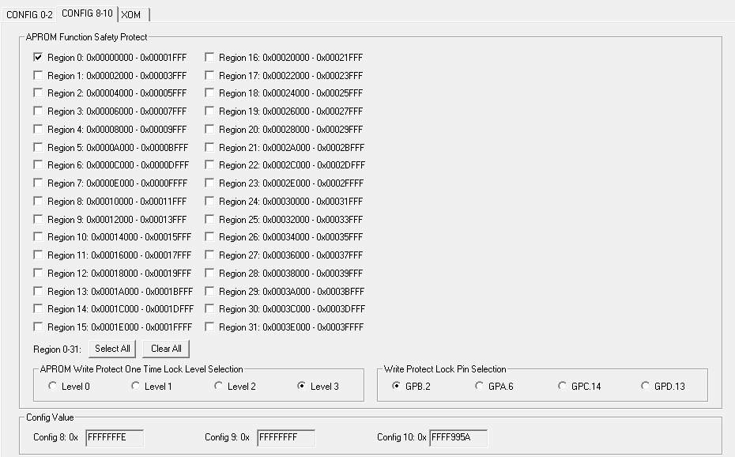
Safe protect

Slide 12
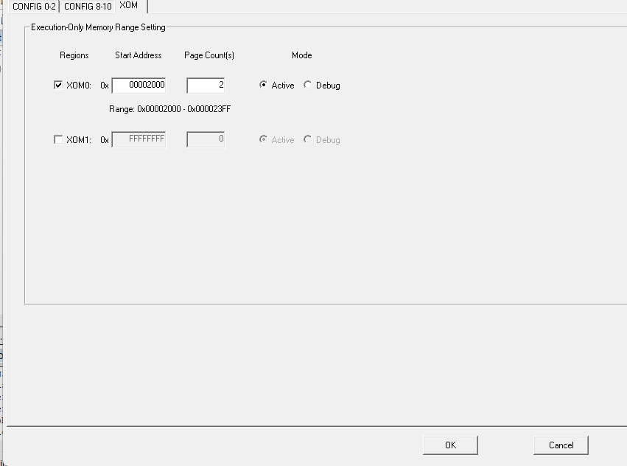
Xom setting

Slide 13
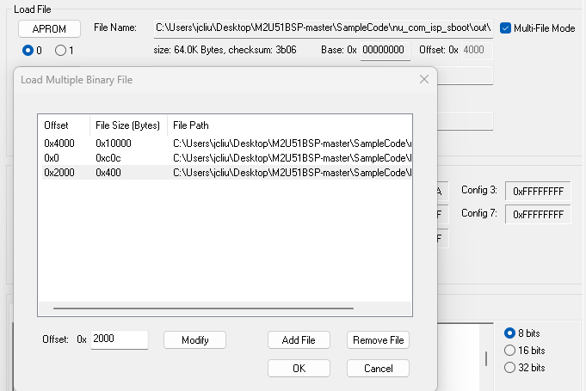
Programming APROM
firmware_signed_64k.bin
ER_ROM.bin(ER_ROM RENAME BIN FILE)
XOM0_ROM.bin(XOM0_ROMRENAME BIN FILE)

Slide 14
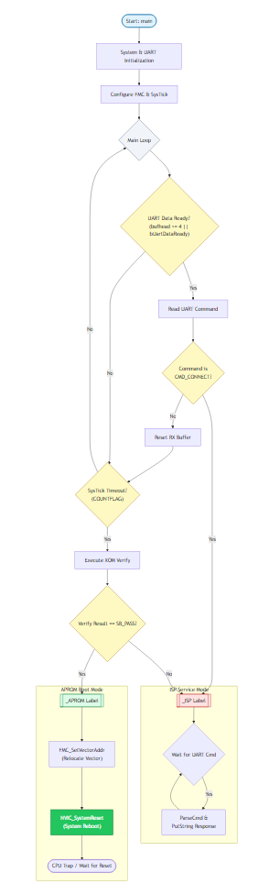
ISP BOOT LOADER

